Slide 1

GIT Clone and Docker Build using Jenkins Automation

Slide 2
01
GIT CLONE
GIT CLONE Using Jenkins Automation Using CI- CD PIPELINE
02
DOCKER IMAGE BUILD
DOCKER Image Build Using Jenkins Automation Using CI- CD PIPELINE
Contents
CONTENTS

Slide 3
01
GIT CLONE

Slide 4
INTRODUCTION
Jenkins is an open-source automation server primarily used for continuous integration and continuous delivery (CI/CD). It helps automate various stages of software development, such as building, testing, and deploying code, by connecting to version control systems
A CI/CD pipeline (Continuous Integration and Continuous Delivery/Deployment) is a piece of equipment that is used for the continuous building, testing, and deployment of software by automating the processes.
Tools: Jenkins, GitLab CI etc..,

Slide 5
CI (Continous Integration):
Ensure that code from multiple developers is integrated and tested frequently.
Developers push code changes to a shared repository (e.g., Git).
Upon each push, automated builds and tests are triggered.
CD(Continous Deployment/Delivery):
Fully automate the deployment of code to production after passing all tests.
After successful CI, code is deployed automatically to production
without human intervention.

Slide 6
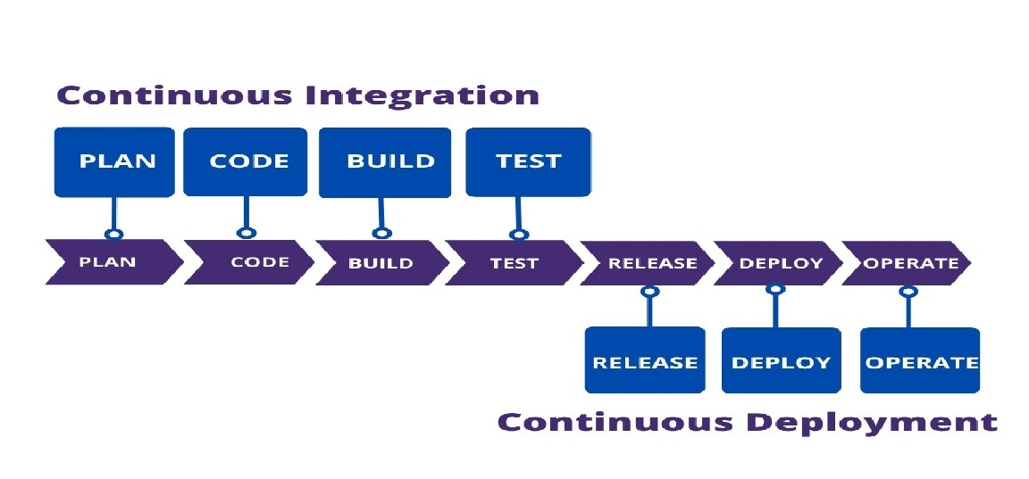
CICD PIPELINE WORK FLOW

Slide 7
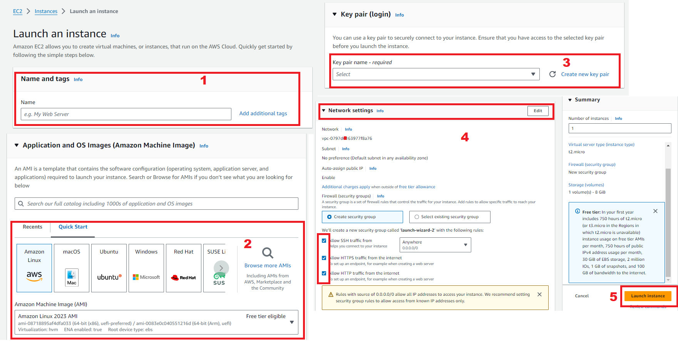
CICD AUTOMATION
First Create EC2 Instance In AWS Console

Slide 8
After Launch the Instance connect GIT bash with Instance SSH link
Then Install Java,Jenkins and Git in the Instance
After installing that need to start the Jenkins
Then connect to the Jenkins Dashboard By using instance public IP address with Prot number 8080.
Then we will get on jenkins page In thet we have red color text need to copy that text and paste in GIT bash by Using cat command to genarte the password.

Slide 9
Paste the passord in the jenkins
After login the jenkins need to Install suggested pulgins

Slide 10
After sucessfully installation suggested we will get login page in thet need to enre below details
User name
Password
Conform Password
Full name
Email
After the all details need to
Click on save and continue

Slide 11
PULGINS INSTALLATION
After creating Jenkins dashboard Need to Manage jenkins---->Pulgins-->Aavilable pulgins-->Install required pulgins like:
Pipeline: Rest API
Pipeline: stage View
GIT Server

Slide 12
TOOLS
Go to Manage jenkins---->Tools-->Add required tools like:
GIT
Manage Jenkins à Tools à Git installations à Name: git à Path: user/bin/git
//To know the git path use the command “ which git “ in the git bash. Then it shows the path//

Slide 13
JDK
Again manage Jenkins-->Tools-->jdk installations-->Name:java
//To know the java path use command “readlink -f $(which java)” and copy the path in jdk//

Slide 14
Maven
Manage Jenkins --> Tools --> Maven Installations --> name should be selected from dropdown --> and the version should be given that has been installed in our local system
//In my case I have installed 3.9.6 version//
Click on Apply and Save

Slide 15
Now Jenkins Dashboard was created In that Create New Item.
Then provide project name and type of project
Then click on OK

Slide 16
After that we will get General Tab
In general We need to provide decscription

Slide 17
After providing Description in General Then goto the Pipleine configure In that pipeline defination select Pipeline script from SCM

Slide 18
Then In SCM Select GIT and provide GIT Repository URL and Credentials

Slide 19
To add Credentials need to Click on +Add and select jenkins
Then the credentials page will open In that need to select Kind as SSH Username with private key

Slide 20
In Credentials need to provide
1.Kind (SSH Username with private key)
2.ID (Any Number)
3.Description
4.Username
5.Private Key
To Generate private Key goto Git bash which was connected to Instance In that need to enter this command to genarate private key “ssh-keygen”

Slide 21
6. After adding all details then Click on Add

Slide 22
After adding credentials select the credentials and Click on Apply and Save

Slide 23
Then we will get project page in that click on Build Now to get Output Console

Slide 24
OUTPUT

Slide 25
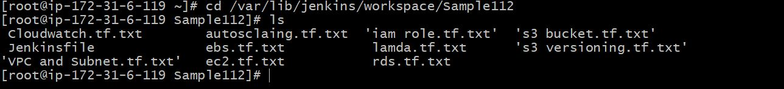
GIT CLONE
After successfully Build then again connect to Gitbash and give the commad “cd ouput building in workspace path” to change into that directory.
After changing into directory use the command “ls” to see all the files of the GitHub repository have been successfully cloned.

Slide 26
02
DOCKER IMAGE BUILD

Slide 27
INTRODUCTION
Docker is an open-source centralized platform designed to create, deploy, and run applications.
DOCKER COMPONENTS:
Docker Containers: A Docker container is a lightweight, executable package of software that includes everything needed to run the application.
Docker Images: Docker images are the blueprints for Docker containers. An image contains everything needed to run an application: the application code, runtime, libraries, and other dependencies.

Slide 28
DOCKER IMAGE BUILD AUTOMATION
Again go to same Project Item and add pipeline script for Docker Image Build
After giving the pipeline script then click save and apply

Slide 29
Then we will get project page in that click on Build Now to get

Slide 30
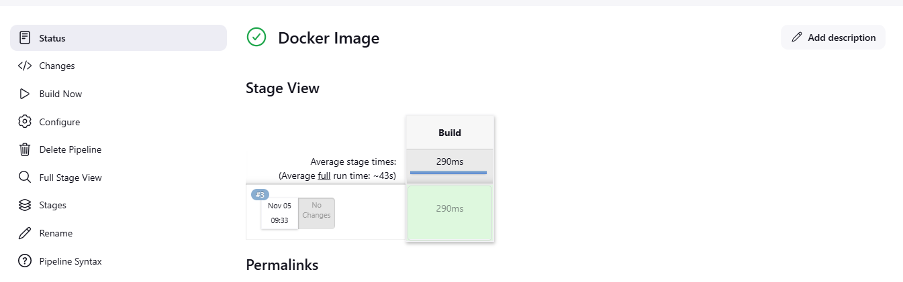
OUTPUT

Slide 31
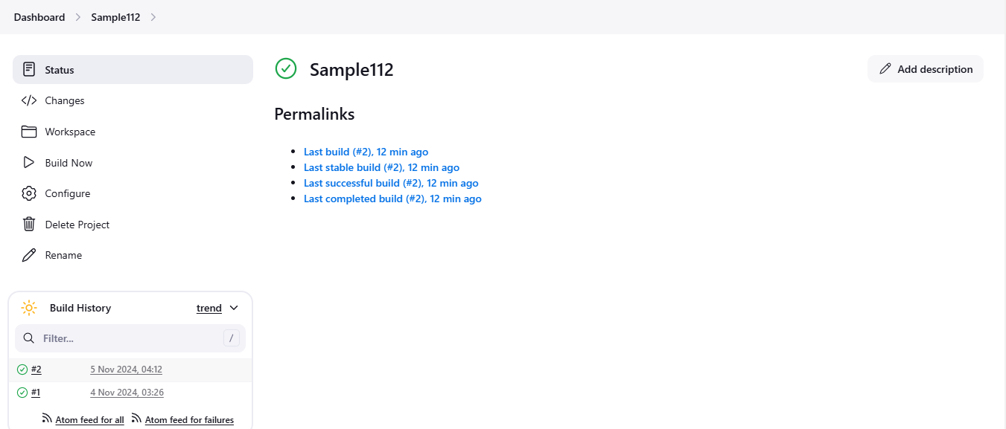

Slide 32


